Slide 1

Question Bank
Minor Proposal-$1^{st}$ __ Defense
on
Suman Adhikari
Ashish Paudel
Shuvam Gautam

Slide 2

Introduction
Question Bank is a web application where students can find academic questions in a single platform .
This helps students in time saving and focus more in question solving rather than question searching.

Slide 3

Objectives
To make students familiar with exam question pattern.
To focus more on question solving rather than question searching.
To provide academic related questions in single platform.

Slide 4
Tools used
PHP, HTML ,CSS
Xampp
GitHub: For Version Control
Databases: MySQL
Visual Studio Code/ Sublime Text
Web browser: Google Chrome, Brave
Lucid Chart: For UML Design
Gimp: For Wire Frame Design

Slide 5
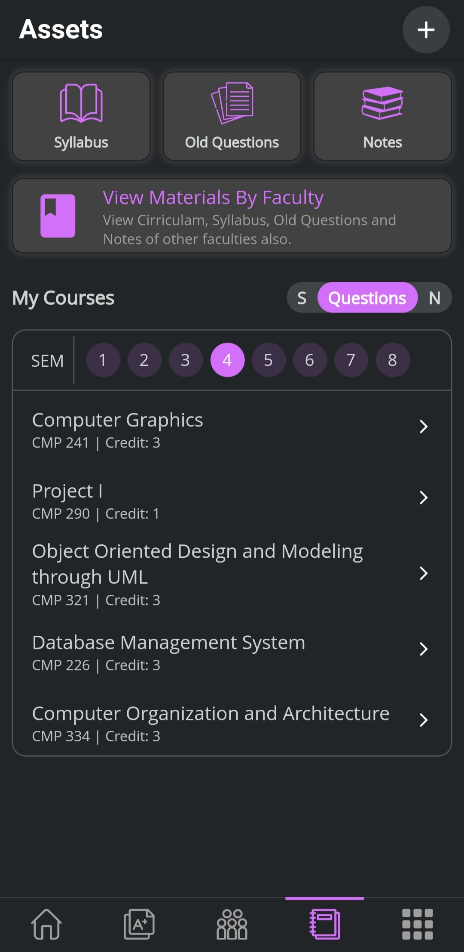
Literature Review
We found some apps and web applications in the market that already have been developed. Some of those platforms are :
PU ASSIST
CSIT HUB
In those platform you have to either follow many steps or download pdf to view the desired question, but this problem is solved by our Question Bank , by providing all questions easily and which can be viewed without downloading .

Slide 6
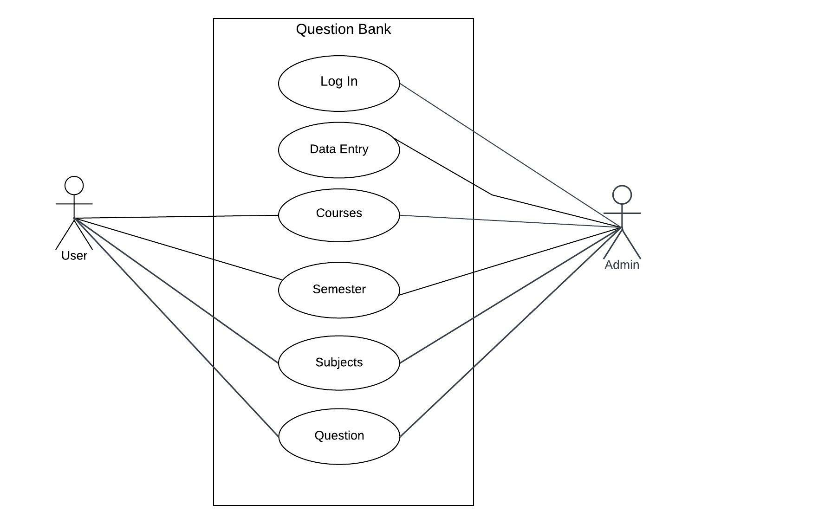
Use Case Diagram

Slide 7
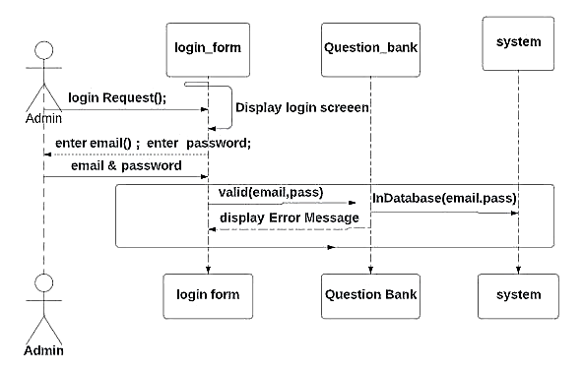
System Sequence Diagram
LOGIN

Slide 8
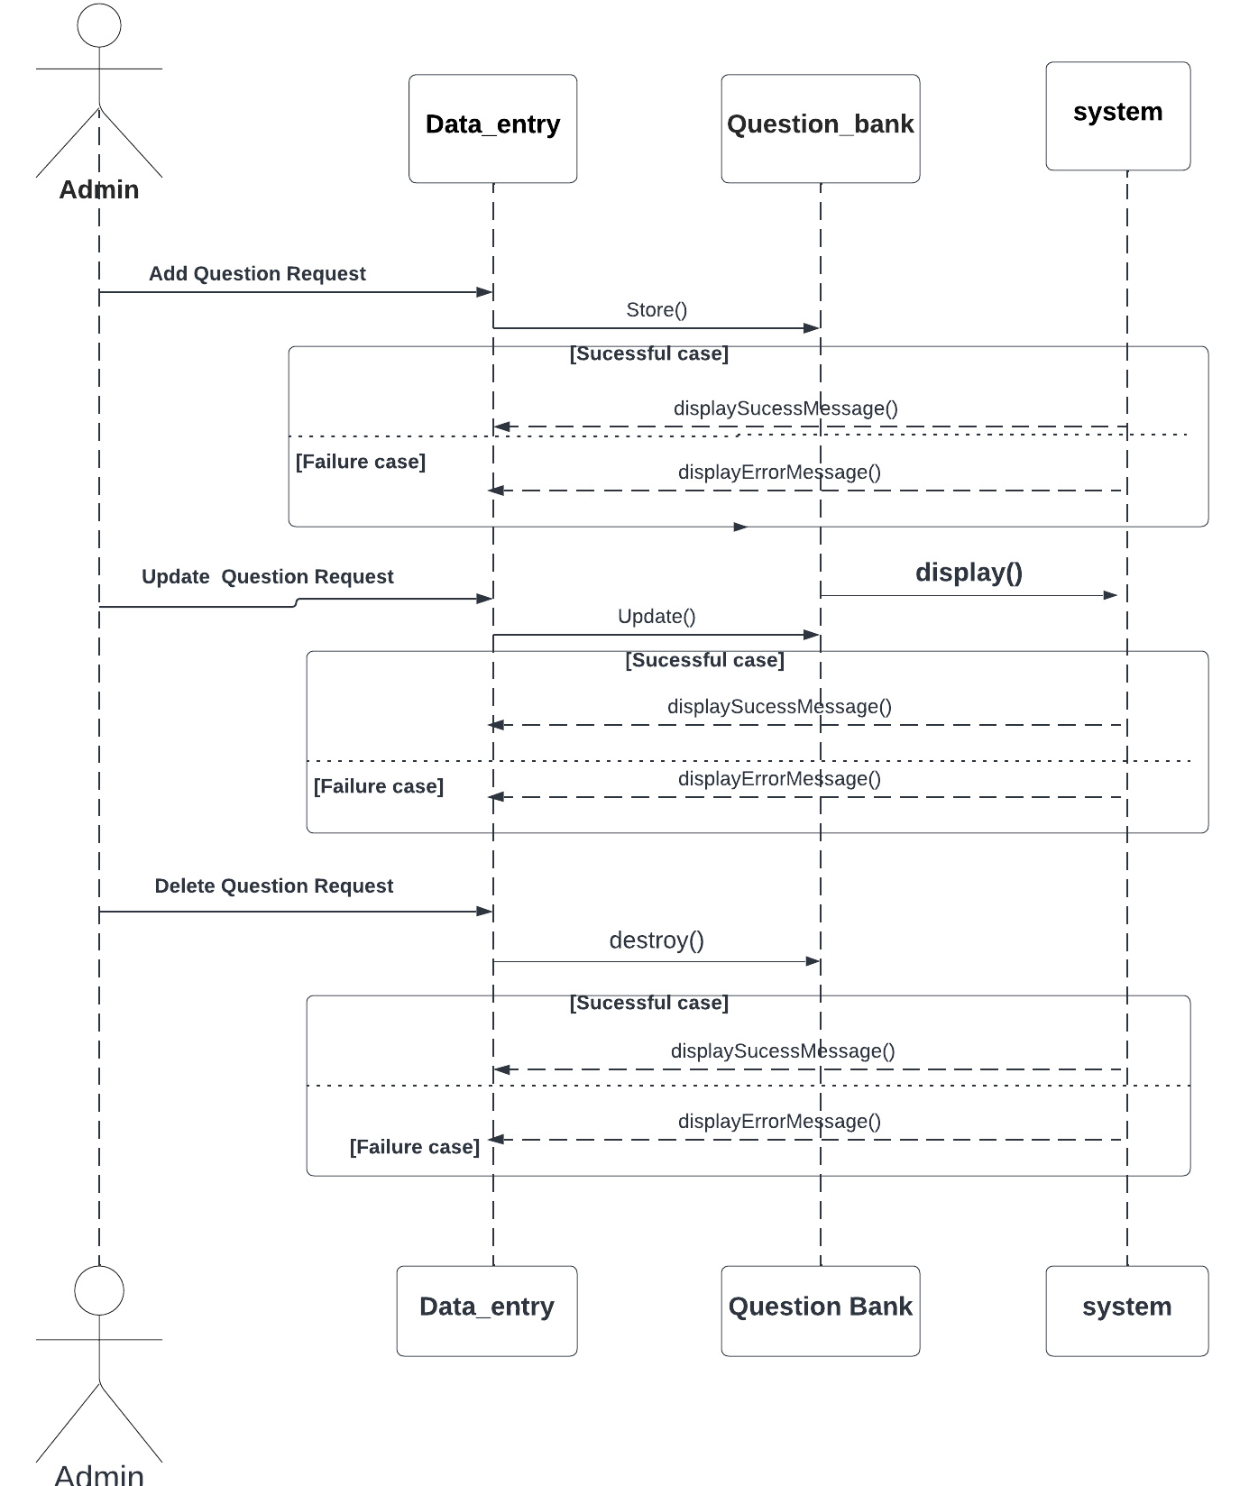
System Sequence Diagram
DATA ENTRY

Slide 9
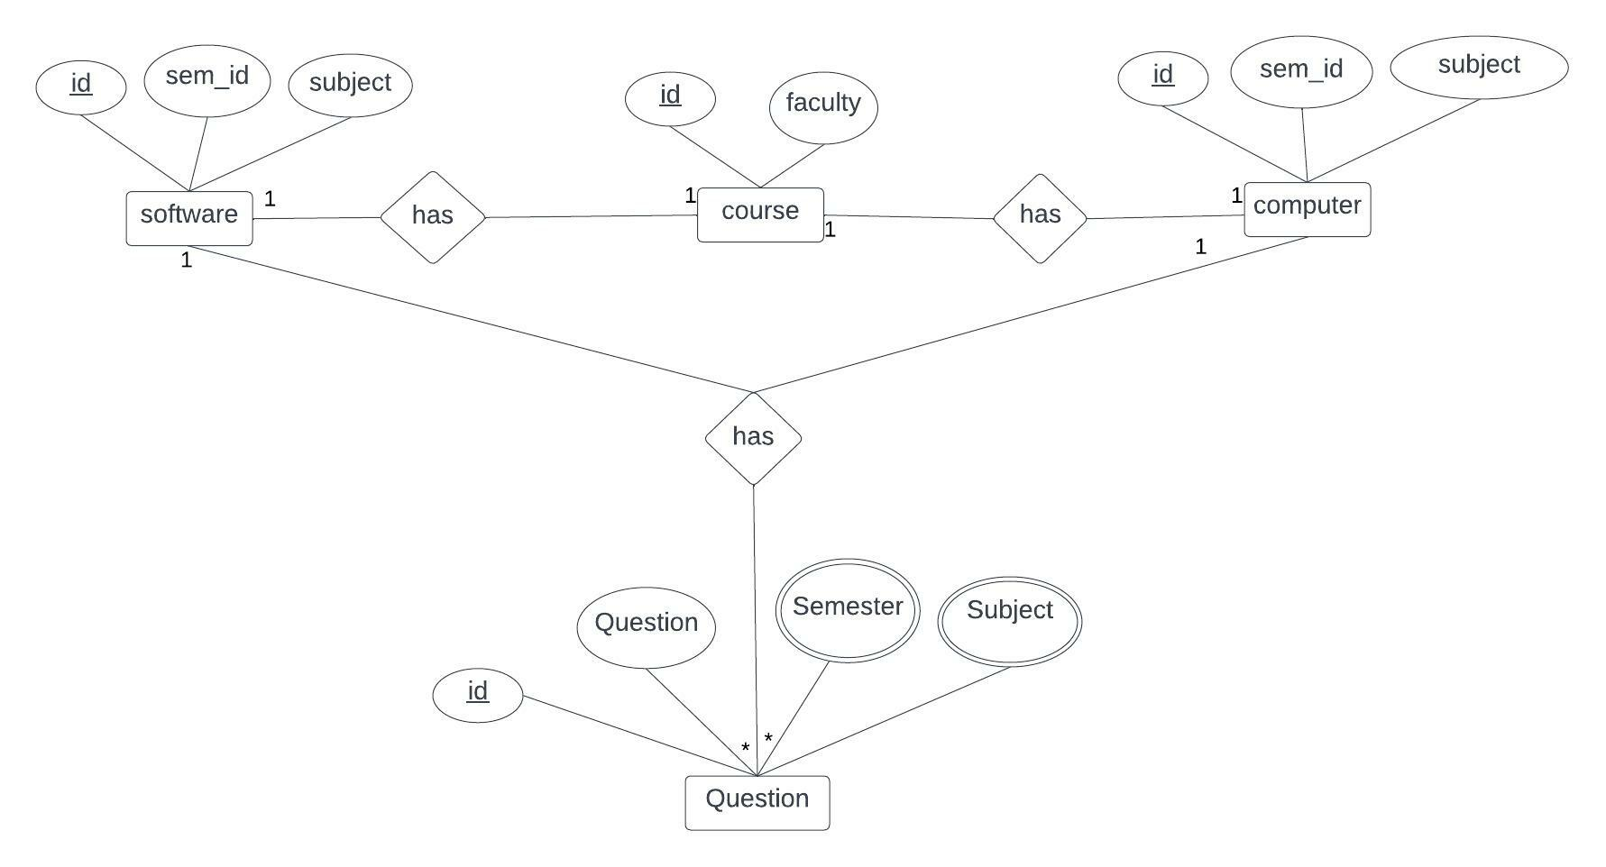
Entity Relationship Diagram(ERD)

Slide 10
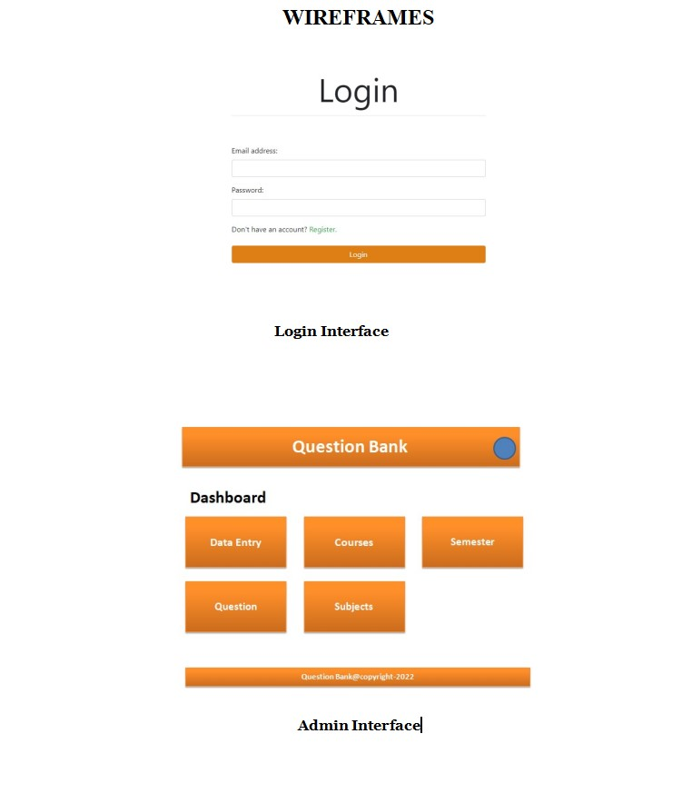

Slide 11
Thank you
ANY QUERIES …

